Slide 1
Introduction to cloud computing
https://ole03.yourlearning.ibm.com/mod/scorm/player.php?a=674&currentorg=articulate_rise&scoid=2857&display=popup&mode=normal&lang=en

Slide 2
An Introduction to Computer Networking
Data
  Information which is translated into a form that is efficient to move through and be processed on the computer network
Cables, Fiber, Optics and wireless signals
  connect device on a computer network
Network Adapters
  Are the interface between the computer and the external network
Routers, Switches and Hub
  Are responsible for directing the flow of data and ensuring that it reaches its destination
Network Protocols
  Example – TCP/IP
Nodes are locations on the network.

Slide 3
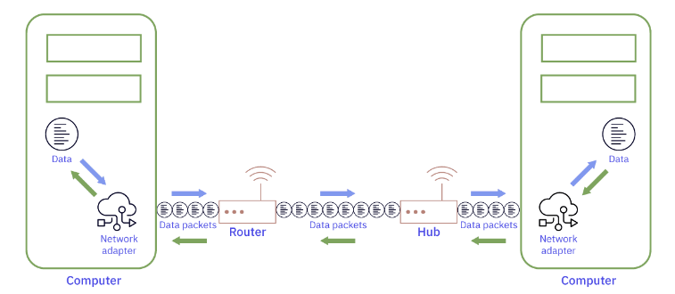
Moving Data
Megabyte – Can store between 1 to 3 seconds of high definition video
Gigabyte – Can hold 9 minutes of uncompressed video
Terabyte can hold 500 hours of high definition video
Packets
  network adapter divide files into packets and send them over the network and then resemble them in the same order
  Small chucks of data that the network groups together
    Sending small packets avoids blocking the network with a large file
    Each packet is independent and can be sent in an order
  Contain MetaData
    enable the routers on the receiving side to assemble the packets in the right order

Slide 4
Evolution of the Cloud
History
  Single Computer with many CPU’s, a lot of memory and hard drive space
    could be under someone's desk
  Server Farms
    Where many servers networked together share the task and workloads
  Cloud Computing
    By separating the features of one server into distinct functions on specifically defined servers
    Made it easier to only use the resources that you needed.

Slide 5
Importance of the Cloud
Innovations the could enables
  Dynamic mapping such as Google Maps
  Identity Access and Management
  Personal Digital Assistances ex. Alexa
  File and photos everywhere and anywhere
  Video and music streaming
  NLP and AI
How the Cloud helps
  The support professionals can focus on fixing the appliance instead of spending time on the phone with the customer.
  Additionally, the cloud service can help ensure accuracy using transcription and simplifies steps like locating the model of the microwave.

Slide 6
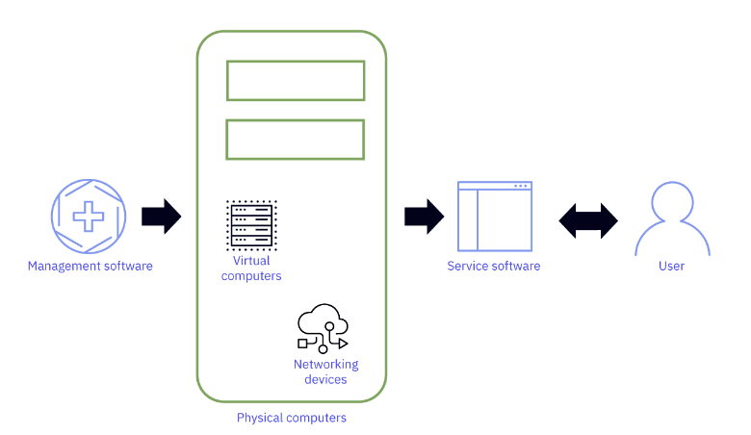
Components of the cloud
Cloud Services are extensions to familiar computer technology
  Physical Computers
  Virtual Computers
  Networking Devices – Move data quickly and accurately over the internet
  Management Software – Use to manage and monitor the cloud infrastructure and
  enforce security policies
  Manage and Monitor the computers both physical/virtual in the cloud
    Use to monitor / provision / enforce security
  Service Software – Interact with the cloud
    Access services and data
Data Centers are the warehouses that store and manage this hardware

Slide 7
A Data Center in Cloud Computing
Designed to provide secure and controlled environments for the reliable operation of cloud infrastructure
  Contains Server, network equipment and storage stems
Make up of Data Center
  Environmental Control -
    Require large amount of electricity
    cooling systems to maintain humidity and temperature
  Physical Security
    Security Cameras
    Access Control Systems
    biometric authentication
  Storage Systems - Both local and networked store for servers to use
  Network Connectivity
  Redundancy and disaster recovery
    Recovery – backup generators, multiple connections
Cloud providers build data centers all over the world so everyone will have fast access.

Slide 8
How Do Technology Advancements impact the cloud
Cloud Computing distributes the hardware and the functions over hundreds and in most cases thousands of computers
  Scalability ( Elasticity )
  Availability
  Resilience ( protection from failure )
    Done with backups
    Multiple Systems

Slide 9
Benefits
Benefits to Users
  Convenience
    Ex. Users can access their data anywhere without carrying it around
  Cost Savings Do not need expensive hardware and software
    Pay for the resource they use
  Flexibility
    Can access computing resource anywhere
  Reliability
    Cloud is always available
  Security
    Data is always protected
Industry
  Innovation
    experiment with new technology and services
  Agility
    Resource can grow and shrink as needed
  Collaboration

Slide 10
Benefits
How does the cloud provide these benefits
  Single Sign On
    One Account to access many dices
  Cloud Storage
  Apps
  Workload
    A specific job that a system performs
      Examples – Backup and Image Storage for mobile devices
      microservices are used
  Connected Device – Other devices can function as extensions of one another with seamless connectivity
  performance – Uses many computer as a first step

Slide 11
The makeup of the cloud
Advances In Cloud Technology
Virtual machines
  help the cloud to scale computing power and enable specialized task
  VM’s run management software which coordinates thousands of virtual machines and physical computers
  Run service software that user access such as admin software for administration to manage their cloud services
Data centers also have hundreds of networking devices alongside the software that runs them.
  These networking devices move data between computers in the data center and between data centers.
Improvements
  Computer
    Efficiency – Computing units are increasing in computing while requiring less electricity
    Reducing Component Size – The Chips continue to shrink in size, but more processing power is added
    Less Moving Parts --- More Solid State Drives
    Increasing Processing Power – Add GPU to certain calculations
  Virtualization
    Container
    Virtualizing Hardware – New Advance is nested virtualization which enables one virtual machine to run inside another virtual machine
      Virtual Machines don’t require physical space and they are more resource efficient than physical machines.
    Servless Computing
    Virtualizing Networks – Independent of the physical network

Slide 12
Advances in Cloud Technology
Network
  Improving Network Protocols Standards that manufactures follow
  Edge Computing Processing data closer to where it is generated rather than sending it to a centralized data center
    Reduce Latency and improves performance
  Intent based networking
    Use network management that uses high level business policies and intent to automate network configuration and management
      Request could be made in Natural Language
      Reduce Human Error
Future
  5G / WI-FI 6
  AI including NLP
  Quantum Computing
  Block Chain
  IoT – Event the smallest devices are connected to the cloud

Slide 13
Understanding Cloud Computing Services
AI and the cloud
Workload – An individual computational task
  Moving Common Workloads
    Save Money
    Scale based on business needs
    Accelerate innovation
AI In the cloud
  How the cloud enables AI Technology
    Data Storage
      AI ( ex. NLP ) uses a lot of data and the cloud uses a lot of data
    Processing Power
      Can scale CPU up when the training set is huge and the algorithm is complicated
    High Availability
      If a computer fails another can take over
      Can make low spec products more powerful
    Experimental
      Can have different type of computers on the cloud such as Quantum

Slide 14
The Internet of Things
Communication between devices and hosts the computing power
  Just need devices to send large amount of data to be processed on the cloud
The devices are equipped with sensors, software and network connectivity
An example : Mobile Phone and Thermostat
Data Generated by IO Devices
  Data And Analytics to
    identify patterns
    detect anomalies
    predicting maintenance needs
    optimizing performance
Scale and Flexibility
  Manage for large scale deployments
  large scale IoT deployments requires a lot of processing / power / storage
Security and Compliance
  Encrypt Data and provide access Control

Slide 15
Cloud Service Model
Software as a Service
  Don’t need to download or install
  Can be installed on devices without a cdrom
  User purchase a subscription
Type of Service Models
  Software as a Service
  Infrastructure as Service
    Access to computing resources over the internet
    Resources can be
      servers
      storage
      networking components
Platform as a services
  Provides a platform to develop / run and manage applications
  Don’t worry OS or hardware
  Pay for only what you use.

Slide 16
Cloud Service Model
Database as Service ( DBaas)
  Provide a Database
  Don’t mange the hardware or service
  Pay for only what you use
Service Models working together
  IaaS and Dbaas provide the foundational layer of computing
  Paas is built on top of Iaas and Dbaas by providing a platform for developing/running and managing applications
  Saas works on top of Paas by proving access to software applications without having to install or manage the software locally
Example Use
  Use Iaas and Dbaas to move their data to the cloud and the database will grow as needed
  Move your software to the cloud migrated to a Paas solution can expand their software and capabilities without having to purchase and manage apps
  By using PaaS the lab can create linux and windows workstations so they can access virtual computer from any locations

Slide 17
Software on the cloud
When to purchase proprietary
  Interoperability
    Needed to work with existing tools and technologies
  Security
    Needed when you can’t look over every line of code
    Might have to transfer security by buying from a company
  Legal Compliance
    compliant with licensing term and avoid any legal issues related to copyright or intellectual property
  Specialized Features
    Features not found in Open Source Software
  Quality and Support
    Purchaser will receive timely assistance

Slide 18
Software on the Cloud
When to use Open Source
  Lower Cost
  Collaborative environment
  Transparency
  Customizability

Slide 19
Overview Cloud Provider Services
Cloud Providers
Features that Cloud Providers Share
  Global Presence
    The closer the faster and more reliable the connection is
  Strong Security
  Reliability
  Scalability
  Standard Services
    IaaS, PaaS, SaaS, DBaaS
  Competitive Pricing
    Pay only for what you use
Hybrids Cloud
  Are good so companies can keep sensitive and legacy on premises
  The Public and Private parts of the Hybrid Cloud are connected
Mutlicloud – Different Clouds being used for their services –

Slide 20
Overview Cloud Provider Services
  Kubernetes
    Automate the deployment, scaling and management of solutions that use containers
    Manage containerized applications
    Can manage both the public and private part of the system
  OpenShift
    Develop, Deploy and manage applications
IBM Cloud Provider
  Hybrid Cloud
  AI and NLP
  Quantum computing
  IBM Cloud Code Engine – A servless platform that enable developers to quickly deploy containerized apps functions to the cloud
  Analytics and artificial Intelligence = leverage data drive insights and optimize operations in a hybrid cloud
    include advanced security features

Slide 21
Overview Cloud Provider Services
  Watson
    Forefront of AI and NLP
      NLP including Translation
      Vision Services Object detection, Face Recognition, Image Classification
      Speech Services – Speaker Identification, Emotion Detection
      Knowledge Services – Data Exploration, Predictive Modeling, Data Visualization
      Assistant Services – Tools for chatbot design / Integration with Business Systems
      Discovery Services 0 – Text Mining, Entity Extraction, Concept Tagging
      Waston Studio – IDE for ML
  IBM Quantum
    qubits – basic unit of quantum information with values 0 and 1 and can be in states at the same time
      can lose their special properties very quickly
    Design new drugs, break secret codes and understand the universe
    Found in the cloud provides access to real quantum hardware and simulators
    Uses
      Health Care – improve patient care and reduce costs by optimizing provider networks, personalizing treatments and detecting fraud
      CERN uses it to study fundamental particles and forces of nature such as the Higgs Boson and the origin of the Universe

Slide 22
Azure
Microsoft Azure
  Integrates well with other Microsoft’s products
  Large Partner EcoSystem
    Collection of ISV, SI ( System Integrators ) and MSP ( Managed Service Providers )
    Dedicated Gaming Cloud Service

Slide 23
Amazon Web Services
Differentiates
  Larger User Base
  Large Community base
Services
  S3 for storage Objects
  Cloudfront for content delivery
  AWS Data Exchange – for ThirdParty and AWS secure file transfer
  Amazon EMR – For processing large amounts of data
  Amazon Open Search – For analyzing data for how a business is operating
  Amazon QuickSight – Dashboards and Visualizations
  Amazon Glue for Data integration and cataloging
  AWS Glue DataBrew for visual data preparation
  SageMaker for deploying and training ML models
  Amazon Comprehend – NLP

Slide 24
Amazon Web Services
Community
  AWS Heroes – exceptional technical expertise
    Community Leadership and Advocacy
  AWS Community Builders – Share and Create Technical content on AWS
  AWS User Groups
  AWS Cloud Clubs peer to peer groups for students
    learn AWS
    career fairs and guest speakers and competitions
  AWS Online Tech Talks
  AWS Community Data
    Community Led Conferences that show case best practices

Slide 25
The Open Source Cloud
Open Source Cloud Software
  Next Cloud
    Stores Share Files
    Collaboration Tools such as Chat and groupware
  Open Stack
    Build and Manage private and public clouds using pooled virtual resources
    Core Cloud Computing services such as compute, networking, storage, image servcies
  Open Shift
    Platform as a Service
    Create/test and run applications
  Eucalyptus
    Implements infrastructure as a service in a private or hybrid cloud
    compatible with AWS

Slide 26
Scenarios where service models are appropriate
Cloud Computing Services that meet specific needs:
  SaaS
    Use when a small company might want to use a productivity suite
    Examples: Gmail, Dropbox, Itunes
  IaaS – Provides virtualization computing resources over the internet
    Pay as you go networking, servers and virtualization
    Manage their own infrastructure
  PaaS
    Deliver a scalable website
Notice – Cloud Base productively Tools
  Cost
    Moving to the cloud based software they were able to reduce overall cost on their IT Infrastructure
  Productivity
    Access of software and files
  Collaboration

Slide 27
Building a business that scales using IaaS
Scaling Up – make existing resources larger by integrating resources into them
  Add more Memory, CPU or storage to an existing server configuration
  Cant’t be done automatically the user need to select a new configuration from the cloud provider
  Vertical Scaling
Scaling Out – Creating one or more copies of a resource to share the workload
  horizontal scaling
  can provide a maximum number that will be created
Can scale out at a specific time or a specific demand determined by data
  Ex. Specific time could be the last week before finals

Slide 28
Summary
There are four types of cloud service models:
  SaaS delivers software applications to users over the internet.
  IaaS provides access to computing resources like servers, storage, and networking over the internet.
  PaaS enables users to develop, run, and manage applications over the internet.
  DBaaS provides users with access to fully managed databases.

Slide 29
Understanding Cloud Deployment Models
Mainframe Computers
  A central computer that does all the processing and sends the result to a dumb terminal
  Today mainframes are used to process large amounts of data
    Process billions of real-time calculations and web transactions every day
  High Processing Power
    some configurations have a built-in AI processing chip to enable artificial intelligence (AI) scenarios without additional hardware
  High Availability
    Redundant components and advanced electronics that deal with errors and other problems
  Virtualization
    Can run multiple operating systems and applications simultaneously in virtualized environments
  Security
    Include Encryption, Authentication and access control
  Management
    Come with sophisticated management tools and automation capabilities to simply administration and maintenance of the system.
  Power some of the most complex and demanding workloads on the cloud.
  Business use them to run their own data centers

Slide 30
Hosting Infrastructure on premises
On Premises Hosting
  Include
    Environmental Control to keep the temperature and humidity within a safe range
    Physical Security – cameras, access to control systems and biometric authentication to prevent unauthorized access
    Storage Service – Include local storage and network storage
    Network Connectivity
    Redundancy and disaster includes redundant power and cooling systems, backup generators and network connections
  Benefits
    high level security and data privacy – have complete control over their infrastructure and can implement their own security protocols
    cost effective for large amounts of data since there is no ongoing costs associated with renting server capacity
    Customize hardware and software to their specific needs
    Ensure they are compliant with regulations or compliance requirements
  Procedure
    Determine the hardware and requirements
    Choose the software
    Install and configure the software
    Connect to the network
    Implement backup and disaster recovery
    Maintain and Upgrade
    Add Innovative Services

Slide 31
Migrating to the Cloud
Why
  flexibility to scale their infrastructure
    hardware investment are costly
    help to adapt to a chaning environment
    Grow more efficiently
  Subscription – Do not need to maintain the hardware or software unless they desire
  Access a range of services. Use the most current software ( ex. data analytics, new ml software )
  Security – cloud providers invest in security measures than businesses can on their own
  Back and Recovery are complete at a difference location by default
  Access to new technologies that might be to expensive for another company to implement
Moves from an on-premises infrastructure to a cloud managed infrastructure
  Assess Current Infrastructure – What hardware / software and services are being used
  Choose a cloud provider
  Plan the migration for both data and services which should include a timeline and contingency plan
  Migrate the data which could include transferring data to the cloud provider’s storage system or a migration tool to copy data over
  Configure Cloud Services
  Test and Validate
  Transition to the cloud
  Decommission on premises

Slide 32
Migrating to the Cloud
Moves from an on-premises infrastructure to a cloud managed infrastrcuture
  Assess Current Infrastructure – What hardware / software and services are being used
  Choose a cloud provider
  Plan the migration for both data and services which should include a timeline and contingency plan
  Migrate the data which could include transferring data to the cloud provider’s storage system or a migration tool to copy data over
  Configure Cloud Services
  Test and Validate
  Transition to the cloud
  Decommission on premises
A hybrid approach
  Businesses will host some hardware and software on premises and use the cloud fo many other services
  By using a mainframe along with cloud computing a business can process large amount of data stored on premises
    but it can use AI to scale and automate data driven insights.

Slide 33
What is Cloud Deployment
Can have multiple clouds to diversify
Deciding which cloud services
  Example
    Business Needs
      Scalable Storage
      Collaboration Tools
      Data Analytics
      Security
    Scalability
    Security
    Integration
Choosing a Provider
  Cost Effective
  Reliable and Reputable
  Support Team

Slide 34
Planning for a Cloud Deployment
Cloud Migration Plan
  Assess the current infrastructure
    Which System, Applications and data you want to move to the cloud
  Identify the right cloud provider
    Focus on security, cost, scalability and availability
  choose the right cloud services
    Which service: Iaas, PaaS, DaaS, SaaS or a combination
  Plan for resource
    Maintenance and enhancement of the data
  Migration Strategy
    Timelines, Resources and potential Risk
  Train the IT Team

Slide 35
Planning for a Cloud Deployment
Making the Move
  Migrate the company’s data and applications
  Validate the test and migrated system
  Monitor the cloud infrastructure
  Decomission on-premises infrastructure
  Evaluate and optimize the new cloud infrastructure
The 6 Rs
  Rehost Identify any cloud base system the business already uses and the system that must be cloned and moved
  Replatform Determine the system that most be optimized to save money, more efficient and more secure
  Refactor Identify the applications that could benefit from cloud capabilities
    Should the development environment be moved first
  Repurchase licenses for your products if needed
  Retire – Determine which applications are not needed anymore
  Retain – Identify the applications that cannot be migrated

Slide 36
Deploying the infrastructure and application to the cloud
Steps
  Design Architecture
    based on business requirements
    Define infrastructure including the
      virtual network
      security groups
      compute resources
    Determine the size / configuration of each infrastructure
  Configure Security
    firewalls
    Access Control List
  Create virtual machines and containers
    Need to select the correct operating system and network settings
  Storage
    What to use Object Storage or Block Storage
  Configure Network Settings so the infrastructure
    subnets
    virtual private networks
    load balances

Slide 37
Deploying the infrastructure and application to the cloud
  Deploy Applications
    Services, databases and cloud infrastructure
    migrate data
  Test and Validate Infrastructure
  Monitor and Mange the infrastructure

Slide 38
Optimizing a Solution
Monitoring
  Efficient
  Reliable
  Meeting performance goals
  Cost-Effective
Cloud Solutions are Optimizations
  Set Performance Goals
  Use Monitoring tools
  Identify Performance Bottlenecks
  Optimize
  Continuously monitor

Slide 39
Cloud Deployment Models
Some companies need to keep their data private because of security / data privacy concerns
Cloud Deployment Models
  Public
    Accessible by anyone on the internet
    Service Provider own and manages the infrastructure, software and other security on the cloud
    typically cheaper and m ore scalable
    Well suite to open source technology
  Private Cloud
    Dedicated to a single organization
    service provider or the organization own / manages the infrastructure, service and security of the cloud
    More expensive and less scalable
  Hybrid Cloud
    Service provider can choose wihc resource and applications runs on each cloud
    More flexible and efficient , but more complex and security challenages
  Community Cloud
    Resource are shared by a group of organizations
    The service provider or one of the organizations owns and manages the infrastructure, services and security
    Cost Effective, but might have less scalability and availability

Slide 40
Private and Public Clouds
Public Clouds
  share infrastructure with other customers
private Clouds
  requires more investment, maintenance and expertise
Choosing a public cloud
  Launch platform quickly
  Scale up or down
  Pay for the resource that you need
  Access many services
  Focus on core Business Activities
  Use Open Source Software for Customer Facing
Choosing a Private Cloud
  Protect sensitive data
  Comply with strict reulations and standards eg. financial industry
  Meet very detailed busines needs and goals
  Have more control of the visibility
  Reduce the risk of downtime or service disruptions

Slide 41
Hybrid Cloud
Use
  private for sensitive data
  public for scalable and cost-effective
  third party cloud for specialized services
Use Case
  Sales process has several steps ( quote, design solution, pricing, financing , preparing, collecting revenue )
  Use profile setting, data from elements and some less-sensitive transactional data
Break Down of cloud use
  public 16
  private 4
  hybrid 80

Slide 42
Choosing an appropriate model
What model is the best match
  private isolate the cloud infrastructure from others
  public share infrastructure
  community pools resource
  hybrid combination of both public and private

Slide 43
Choosing a Public Cloud
Choosing a public cloud deployment
  Time Considerations
    Don’t need to set up infrastructure
    deployment is relatively quick
  Application
    No legacy or proprietary applications that require a specialized infrastructure
  Cost
    Do not have to hire specialized IT Personnel
  Data
    No sensitive Data or regulated data
    secure data, but does not require full visibility and control of the infrastructure that manages it.

Slide 44
Choosing a Private Cloud
specific requirements that cannot be met in a public or hybrid cloud
A private cloud can be host on or off premises
Choosing a private cloud
  High Security and Compliance needs
    offers more protection for sensitive data and applications to meet specific regulatory industry standard
  High Performance and availability needs
    Can offer the business more reliability and scalability for demanding workloads
    helps to reduce latency and network congestion
  High customization and integration needs
    control the configuration and management of the cloud infrastructure and services
    helps to integrate with existing applications and systems
Examples
A financial institution can use a private cloud to store and process customer data and transactions, while complying with banking regulations and audits.
A gaming company can use a private cloud to host and deliver its online games, while ensuring high-quality user experience and minimizing downtime.
A manufacturing company can use a private cloud to run its own software and hardware platforms, while integrating with its legacy systems and processes.

Slide 45
Hybrid
Edge Computing – way of processing data closer to where it generated or used instead of sending it to a server or cloud
Why would you use a hybrid cloud
  reduce cost Business can avoid paying for unnecessary resources or security models that they don’t need for every workload
  minimize risk data breaches, compliance, violations or service outages
    private Data is protected by its own security practices and standards
  Extended Capabilities
    Scalability, agility, innovation and performance
Examples of use
  Put in Later

Slide 46
Virtualization of the Cloud
Virtualization
  Process of creating a virtual representation of a physical resource
  Improve efficiency, scalability and flexibility
  Access services over the internet without maintain the underlying software
  Cloud providers provides 3 type of virtualization
    Virtual Machines
    Virtual Storage
    Virtual Networks
Virtual Machines
  A software based emulation of a physical comptuer that can run different OS and applications
  Each physical computer can run or host multiple vms
  Have their own virtual hardware such as CPU, memory, disk and network devices that are isolated from the host system
  Can easily create/move/copy or delete a VM
  Can use a VM for specific jobs and then shut it down to free up resources

Slide 47
Virtualization of the Cloud
  Uses
    Testing and Development
      create multiple software and hardware environments
      Simulate network conditions and human behavior
      Can use them to develop software which needs access to low level resources and devices
  Server Consolidation
    Multiple Servers can run on a physical machine
    Improve server utilization and performance by dynamically allocating resources according to workload demand
  Disaster recovery and backup
    Can replicate and move them to different locations – high availability
    Easy to backup and restore
  Security and Isolation
    Prevents malware or malicious users from accessing or compromising host system
    Sandboxed Environments – Run code from unknown or untrusted sources to protect the system/hardware

Slide 48
Virtualization of the Cloud
Virtual Storage
  Pooling of physical storage from multiple networked devices into what appears to the user as single storage device
  Examples of virtual storage – Dropbox, Google
  How does it work
    Upload the data via an internet connection
    Manage Data – The data is spread across multiple virtual machiens in data centers across a region or the world
      Impact on users : Improve availability of the data
    Increase Storage – More virtual storage ( virtual machines ) is started
    Access Data
    Virtual Storage on the clould
      Public Cloud Storage
        Data is in a service provider’s data centers
        Data is spread across multiple reginons
        elastic
        Available from any device
      Private Cloud Storage
        Organization uses its own services and data centers to store data within their own network
        Can used dedicated servers and private connections from cloud service providers and connections not shared by any other business
        Used for compliance and security requirements

Slide 49
Virtualization of the Cloud
    Hybrid Cloud Storage
      Mix of public and private
      Allow the business to decide which data it want to store in the public or private
    Multi Cloud Storage
      Use multiple public cloud providers to store different types of data
      Avoid vendor lock-in, optimize cost, improve performance and enhance security

Slide 50
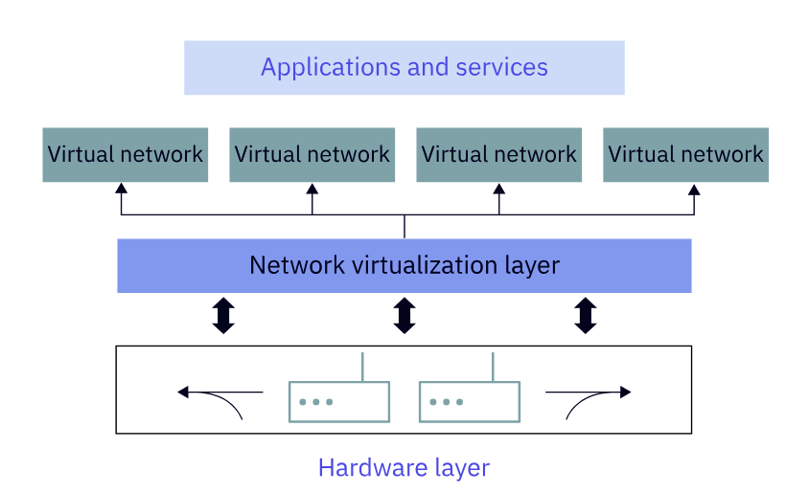
Virtual Networks
Create a network using software based network components.
Simulate the functionality of a physical network including routing, switching, firewall and load
balancing
How Do virtual networks work
  Hardware layer – Contain Physical network components like routers and servers.
    Foundation for the physical network
  Network virtualization layer
    Build on top of the hardware layer
    Multiple virtual networks can coexist and operate independently which sharing same physical resources
  Virtual Network Layer
    Contain virtual routers, switches and firewalls and other device
      provide network services and connectivity needed by virtual machines.and other network services
      Include service like DHCP and DNS
  Application and services layer
    services or workloads that use the virtual network layer to provide network connectivity

Slide 51
Virtual Networks
  Various Purposes
    Isolating and securing different segments of a network
    Connecting different physical locations or cloud services over the internet using encryption tunneling protocols
    Enabling performance and availability by distributing the workload across multiple regions
    Experimenting with technologies

Slide 52
Containerization
lightweight form of virtualization that enables applications to run in isolated environments on a single host operating system
Container services can cost less and are faster and require less resources
Container benefits
  lightweight and portable
    Containers use a shared operating system and only contain the application and dependencies
    Computer have their own OS and hardware resources
  Isolated and Secure
    Run in a sandbox which limit access to other containers
    Less chance of code impacting the system
  Scalable and Efficient
    Developers can easily develop replicated and update containers across multiple hosts
    Computers require more time to setup, maintain and upgrade
  Containers are inoperable
    Can run on any platform that supports the container software technology
    Compatibility issues with different hardware or software configurations

Slide 53
Containerization
Containerization and virtualization are two methods of creating isolated environments
Differences
  Virtualization – Creating one or more virtual machines to provide a recourses for performing various tasks
  Containerization – Creating containers that run applications and service for performing tasks
Differences
  1st difference
    Virtualization – Emulate the complete OS and hardware in a physical server
    Container – Share the same hardware and OS as the host
  2nd difference
    Virtualization – Each VM has its own operating system, application and configuration files
    Container – has its own applications, libraries and configuration
  3rd Difference
    Virtualization – Multiple VMs can run on the same physical server each with its own resources and settings
    Container – A light weight and self contained package of software that can run anywhere that supports the same OS

Slide 54
Containerization
Main Difference
  Virtualization
    Use the hardware of the host computer
    called hardware abstraction level
  Containerization
    Uses the hardware and operating system of the host computer
    Operating system abstraction level
Abstraction – Creating a layer of separation
  Containers – Do not need to start an independent operating system they are more efficient than VMs in terms of resource utilization , startup time and performance
  Containers – Share the same os as the host they are less secure
  Containers only run on host with the same os.

Slide 55
Container Tools
Docker
  Create and manage containers using a client server architecture
  Background Docker daemon that handles container operations and exposes an API for communications with other tools and services
  Command Line Communication
  Docker Swarm – a native orchestration tools for managing multiple docker hosts and containers
Kubernetes
  Manages group of servers and containers
  Deploy and Scale containers and make sure they are balanced and healthy
  Pods
  Communicate with Command or GUI
Podman
  Can manage and run containers without needing an additional program to do so
  Based on model that allows it to run multiple containers together
  Communicate with CLI or GUI

Slide 56
Containerization
Security
  needs access to the host os or root privileges to run background process which is a risk
  Podman and Kubernetes run as non-privileged users by default and don’t need a background class
    More secure and less vulnerable to attacks
  Kubernetes also use role based access control
Architecture
  Docker – All container features into a single tool
  Kubernetes – separates it container features into different components
  Podman – Linux features to run contgainers without needing a background process
    Architecture is more lightweight
Functionality
  Docker – Manager containers
  Kubernetes – Orchestrating containers
  Podman – Running containers
Docker is suitable for developers who need a simple and comprehensive tool to create and run containers locally or on a signle host
Kubernetes is use for a powerful, scalable tools to manage clusters of servers and containers across different environments
Podman is secure and lightweight to run containers individually or in a pod without a daemon

Slide 57
Containerization
Advantages
  enable faster innovation, lower cost and high quality
  Compatible with DevOps
  Easier to test and deploy and update applications
Benefits
  Run on any platform without requiring changes to the code
  Create./Destroy containers in seconds
  Containers can be grouped into clusters
    Collections of containers that work together to provide a service or function

Slide 58
Containerization
Microservices
  Software goes modular
    Services – functions that perform a specific task
    Microservices – An architecture of loosely coupled services
    Microservices communicate using applicaotn programming interfaces (APIs)
  Benefits
    Faster development, easier deployment and more flexible scaling of cloud application
    Different technology stack for each service
    Deliver agile and resilient software for the cloud
  In practice
    Discovery
    Gateway
    Rest Interface
    Configuration Manager
    Containerization or Springboot
    Test Microservices – Jenkins or Bootlab
    Monitory

Slide 59
Containerization
Container can avoid the problems of incompatible software version, conflicting dependencies and varying os
Deploy a microservice
  Write the code
  Create the container image
  Test the container image
  Public to a registry such as Docker Hub
  Deploy the container
How microservices communicate
  API – A set of definitions and protocols that enable two software components to communicate with each other
  Specifies what sort of data can be sent and received
  Work together as a cohesive system while maintaining their autonomy and scalability
Benefits of a microservice
  Modularity Each microservice can be developed / tested / deployed independently
  Reusability Microserivces can be reused by different apps
  Scalability Each indivual microservice can be started or stopped
  Reliability If one microservice goes down another will go up
  Flexibility Each microservice can use a different task

Slide 60
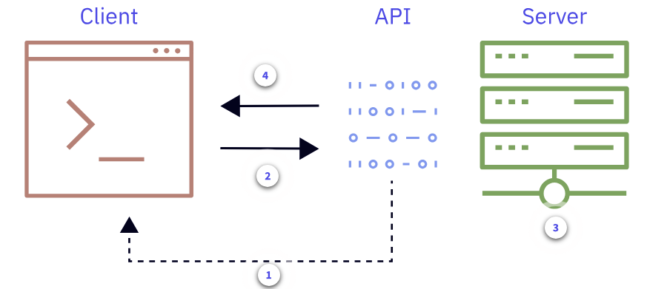
Containerization
Application programming interface
  A set of rules and instructions that allow different software applications to communicate and exchange data with each other
  Definitions
    Call to the API is the same as request in Rest API
    response

Slide 61
Containerization
APIs role in cloud computing
  enable development, integration and management
  Allows developers to access and use the functionality and resources provided by the cloud service (ex. AWS)
  Allow users to connect multiple cloud service or platforms or to connect cloud and on-premises
  Three Types of API
    Service API – Provide access to specific cloud services such as storage, messaging and analytics
      Ex AWS S3 – store and retrieve objects
    Application APIs – Provide access to specific cloud applications
      Gmail
    Infrastructure APIs – provide access to low level cloud infrastructure components such as virtual machine, containers and networks

Slide 62
Containerization
Automating cloud tasks using API(s)
  Each api call can initiate a task which can return some data and/or a event
    event – Change to the computer system
  How an API works
    Configure the email service provide API
    Integrate the API into the application ex. send request to the API
    Setup the email templates
    Trigger emails
    Monitor email and delivery analytics

Slide 63
Containerization
Containerization
  Legacy programs
    difficult to update and keep running usually
      Difficult to maintain and update due to their traditional architecture and complex dependencies
      costly to run due to high resource consumption and low utilization
      security issues due to outdate code and infrastructure
    To make them work better move them to containers, microservices and APIs
  Steps
    Analyze to determine the core functionalities that they can break down into services and focus on reuse
    Design and develop mcirservices that match these functionalities and components
      Each microservice communicates using an API
    Package – For each container package all the code and dependencies into a container
    Deploy – Each container image to the cloud platform that provides management and monitoring tools
      service mesh – connects and manages the communications between microservices
    Test – validate the functionality and performance of the migrated applications
      Use DevOps for this section
    Monitor and log

Slide 64
Containerization
Using Containers, Microservices, API to build APPs
Business value
  Build scalable applications that can run only on any platform
  Adapt to changing customer needs and preferences
  Integrate with other systems and services and easily and securely
Fullfillment
  Containers provide a lightweight and portable way to package and deploy application
  container make it easy to scale applications up or down
    companies can reduce cost when volume is low
    efficient use of resources
Modularity
  Each microservice is made up of service. Each service can be scaled up or down
    Do not have to scale the entire application
Availability
  Especially Kubernetes which has automatic fail over and rolling updates
    Ensure the correct number of instances per service and they are running

Slide 65
Best Practices when using containers and microservices
Design each microserivce to be loosely coupled and highly cohesive
  Clear and Single Responsibility
    minimize dependencies on other services
    Result Test, Deploy, Update each microservice independently
Use a consistent and standardized approach to communicate between microservice
  Use Rest API, JSON and message queues
  helps interoperability, reliability and message queues
Implement proper logging, monitoring, tracing mechanisms for each microervice and the whole system
Use a container orchestration tool to automate and manage the deployment, scaling and configuration of the containers
  Help to simplify the complexity of managing many containers across different environments
  container orchestration tools : Docker, Swarm, ECS
Security
  communication between microservices using encryption and authentication
  securing the containers
  scanning, limiting privileges and enforcing policies

Slide 66
Developing and Deploying Software in the Cloud
Cloud Base Development Benefits
  Scalability
  Cost Efficiency – Need for upfront investment and reduces cost of ongoing software
  Collaboration – Work and communicate from anywhere ijn the world
  Innovation – Access to AI, Big Data and IoT

Slide 67
Developing and Deploying Software in the Cloud
culture and practice of collaboration between developers and operations teams
Team using traditional DevOps can face challenges such as
  Limited Scalability
  Reliability
  Cost Efficiency of their infrastructure
  Lack of standardization and automation of their processes
  Difficultly sharing knowledge and best practices across their temas
Cloud Based Dev Ops
  Multiple Environments
    Create and Test applications on various environments without having to worry about the underlying hardware or software
  Continuous Agile Process
    Cloud Based DevOps Tools – Faster Feedback, Continuous integration
  Valuable Tools
    Provide tools and services for automating and managing the deployment and configuration of applications and infrastructure as well as monitoring and trouble shooting
  Better Delivery
    Scalable, reliable and cost effective way of delivering software applications to customers

Slide 68
Developing and Deploying Software in the Cloud
  Advantageous
    culture of collaboration and learning
    cloud functionality to plan, track and discuss work across teams
    cloud functionality to review, integrate and build code
    Test and ship applications with confidence
  Best Practices
    Plan for Portability
      Use protocols, data formats and design patterns
    User Servless Computing
      Don’t manage servers
      The cloud handles scaling, provisioning and maintenance of the resource
  Provide Security
  Consider different
    Run on different IT envi9ronemnts – development, testing, staging and production
    Design software to allow transition to the different stages above.
SLDC : Plan, Design, Develop, Test, Deploy

Slide 69
Developing and Deploying Software in the Cloud
  SLDC
    plan Which cloud provider do you want and analyze requirements
    design and the architecture and structure of your software
      Chose technologies, tools and frameworks
    Develop Write the code
    Test Both manual and automated
    Deploy Manage its performance, availability and security
Orchestration
  managing and automating the different tasks and processes involved in running applications and workloads
  Cloud – handle applications running in one or more clouds
  Automation
    performing operations on components of a cloud environment
  Cloud Orchestration Methods
    Imperative Developers specify exact steps of execution for their automation tasks
    Declarative Orchestration Developers specify the desired outcome

Slide 70
Developing and Deploying Software in the Cloud
  Cloud Orchestration Advantageous
    reduce manual work, errors and delays
    improve standardization and consistency
    accelerate delivery and innovation
    enhance visibility and control
    optimize resource and performance across cloud environment
  Imperative orchestration
    requires skills and knowledge to maintain the scripts or workflow
    Benefits
      Control
      Specific Steps
  Declarative Orchestration
    Ex. Kubernetes or Jenkins
    Advantageous
      Faster to set up
      Consistency
      Dynamically adjust and adapt their cloud services

Slide 71
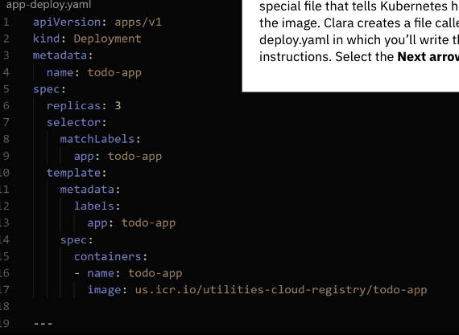
Developing and Deploying Software in the Cloud
    Using Declarative Method
      Define the components ( e.g web server )
      Specify the properties and policies of each component
      Don’t need to worry about installation, configure, connect, monitor or update
    Declarative Use Cases
      Complexity of the tasks
      Optimizations
Infrastructure as Code
  Configure resources using script or lines of code instead of manually
  Ex Kubernetes
    Automate deployment, scaling and management of their apps
    Ex. how many replicas, where the containers should run
Commands
  dokcer tag tod-app:latest us.lcr.is/utiltiies-cloud-registry/todo-app
  To deploy an Kubernetes, place kubectl apply -f app-deploy-yaml
  kubectl ls --cluster mycluster-free
  kubectl describe service todo-app
  app-deploy.yaml

Slide 72
Introduction to Data Management int the Lab
Security in a Wired World
  Physical Security
  Username and passwords
Beyond the Front Door : Protecting user Data
  Strong passwords use a random mix of Uppercase/LowerCase of letters, numbers, special characters
  Using Biometrics – Recognize Face, fingerprint, voice or retina
Password Protection Layers
  Two factor authentication
  multifactor authentication
  Assumption for the previous 2 authentication : If some one knows your password they won’t have your cellphone where the second code was sent
Data in a security Cloud
  Encryption in transit Data is encrypted when moving through the internet
  Encryption at rest Data is encrypted at rest
  Providers design systems so only their tools can decrypt the data

Slide 73
Introduction to Data Management int the Lab
  Find pattern in behavior either by someones action or a comput system watching for this behavior
    Ex. of someone action Assume the person uses it around that is not being used in his hometown that mgith raise a flag
    Ex. of computer – The computer realizes that you are logging from a different computer then it might alert you
  Software to protect your computer
    Use Virus scanner, firewall
    DoS – Denial of service attacks
    Tool to prevent
      Prevention Tools – prevent fake request from reaching the website
      Monitoring Tools
      Development Tools – Get Alerted about problem that can cause security issues
  Complying with security regulations
    Security Regulations – Rules and Standards that aim to predict the confidentiality, integrity, and availability of data and systems in the cloud
      Ex. Hippa
      PCI ( Payment Card Industry )
      DSS ( Data Security Standard )

Slide 74
Introduction to Data Management int the Lab
Compliance
  Help to mitigate the negative consequences of security incidents : Legal Penalties, reputation damage , customer lo0ss or operational disruption
  Enhance Trust or confidence
  Enable solutions to meet the expectations and nees of different markets and regions
Best Practices
  Assess Conduct risk assessment to identify and prioritize the potential threats and vulnerabilities in the cloud environment
  Control Implement appropriate security controls to protect the data and system from unauthorized user
    measure include: encryption, authentication, authorization, firewall, antivirus and backup
  Monitor
    for issues or gaps
  Educate and train
  Review

Slide 75
Introduction to Data Management int the Lab
How can a beach impact a company’s reputation
  Loss of Credibility
  Legal Liability
    Lawsuits and might have to compensate customers
  Brand Damage
Some measures include:
  Implementing robust cloud security policies and practices
  Educating employees and customers about cloud security risks and best practices
  Encrypting data in transit and at rest
  Using strong authentication and authorization mechanisms
  Monitoring and auditing cloud activities and events
  Updating and patching cloud systems and applications regularly
  Having a contingency plan and a recovery strategy in case of a breach

Slide 76
Introduction to Data Management int the Lab
threat actor – An unauthorized part access a compromised laptop to access the company's development environment
Have a well planned incident response plan
  Secure physical areas potentially related to the breach.
  Mobilize a breach response team right away to prevent additional data loss.
  Assemble a team of experts, such as a data forensics team, to conduct a comprehensive breach response and consult with legal counsel.
  Take all affected equipment offline immediately, but don’t turn it off until forensic experts arrive.
  Review the company website if the data breach involved an attack on web-based services. And review other websites for copies of stolen data.
  Talk to the people who discovered the breach and anyone else who might know about it.
  Don’t destroy any forensic evidence during the investigation and remediation.
Chief Data Officer is responsible for the data strategy including data breaches

Slide 77
Introduction to Data Management int the Lab
Vulnerability is a cloud base weakness or flaw in the security
Attack Vector – A way cybercriminals can access or damage cloud data
common Attack Vectors
  Misconfiguration of settings
    Too more access to a data storage service might expose sensitive information
    Solution : Follow best practices and guidelines by their cloud provider
  Poor Access Management
    lack of proper authorization or authentication
    Ex. Don’t use strong passwords or use multi-factor authorization
    Phishing Attacks and brute force attacks or common for this section
    Principle Design of Least Privilege
  Insecure API
    Example if the API does not validate input/output
    encrypt in transit
  System Vulnerabilities
    Flaws and weaknesses in the software or hardware components that attackers can use to compromise its security
    Ex. Not apply patchers regularly
  Lack of Monitoring
    Does not keep track or provide alerts on it activities

Slide 78
Introduction to Data Management int the Lab
Ways to mitigate vulnerabilities
  shared responsibility
    Cloud Service Provider and customer have roles and responsibilities
      CSP – Securing the infrastructure ( including hardware )
      customer – Secure : data, applications, access to their environment
  Defense in Depth Strategy
    Implement multiple layers of security
    ex. firewalls, intrusion detection
    prevention systems,
    antivirus software
    web application firewalls
    encryption
    backup
    vulnerability scanning
    monitoring
  Principle of Least Privilege
  Patching and updating

Slide 79
Introduction to Data Management int the Lab
Implementing cloud security principles
  Shared Responsibility Model
  Building a strong defense
    in depth strategy has reduced the attack surface
Challenges
  The Human Element
  Keeping up on every thing

Slide 80
Introduction to Data Management int the Lab
Accessing Systems and Resources
  Authentication
    Security measure that strengthens access points
    lock screen provide authentication service those with valid usernames and passwords to access a device
    authenticate with fingerprints, , facial recognition and voice prints
  Authentication
    provides access to resources within a system
  Many cloud systems automatically authorize authenticated users of a particular service to access the resource of the service, but may be authenticated to access your file
Authenticating and Authorizing users in the cloud
  Profiles on os ( ex. children ) or a streaming service using a the ip address to prevent sharing is a form of authentication
  Pass through authentication ( Single sign on )
  Trust relationship
    networks can determine the source of a network using request ipaddress between various networks
    intuitions can setup a trust relationship to share limited user information
    Ex. can give you access other resource

Slide 81
Introduction to Data Management int the Lab
Cloud Administration uses policies and procedures to enforce rules and protect data
  Policies are set of conditions an actions that define what users can or can’t do in a cloudl service
  Procedures are steps or instructions that cloud administrators follow to implement polices
  Policies and procedures can be used to grant different levels of access to different users or groups of users
  Policies and procedures can help with monitoring and complying with security standards and regulations
Zero Trust Model
  Any device is considered untrusted at all times regardless of whether they are inside or outside of an organization’s network
  used where the devices can be accessed from anywhere
  Based on three principles
    Verify explicitly Must authenticated and authorize every access request based on multiple factors such as identify, location, device, heath and data sensitivity
    Use least privilege access
    Assume break to minimize potential attack
      encrypt data
      segmenting networks
      monitoring for anomalies

Slide 82
Introduction to Data Management int the Lab
purpose of zero trust for organizations
  Improve security
  enable digital transformation
  empower productivity
  comply with regulation
  reduce cost and complexity
Strategic approach
  Identity verify the identity of every user before granting access to resources : Use multifactor authentication
  device Only secure and compliant device can use the network
  application Use application security
  Data Use encryption
  networks Use networks and subnet them

Slide 83
Introduction to Data Management int the Lab
  Multifactor Authentication
    Need two pieces of information or more
  Identity application
    A unique string of numbers that changes every minute.
Benefits of using Dbaas
  Choose : Type, capacity and performance
  Do not deal with installation, configuration, backup, recovery, scaling which the provider takes care of
  Advantageous
    Cost Pay for what you only use
    Flexibility scalability
    Availability
    Security encrypted and protected by the provider
    Reliabiltiy
Security Features of Dbaas
  Encryption
  Backup and Recovery
  Access Control

Slide 84
Introduction to Data Management int the Lab
Data Governance
  A collection of processes, policies and roles, metrics and standards that ensures an effect and efficient use of information in the cloud
  Helps to ensure data is clean, accurate, secure and available for authroized user
Data Compliance
  adherence of the rules and regulations that apply to the data in the cloud.
  Could include industry, government, contractual or ethical
Importance of data governance and compliance
  avoid data breaches
Certify Compliance
  Certificates such as Federal Risk and Authorization Management Program (FedRamp)
  Providing Tools to manage data : encryption, backup, recovery, access control, logging, auditing
  Providing Documentation : Service Level Agreements and Terms of Service
  Collaborating :
Tool : IBM Cloudant Data – Good for web/mobile/servless

Slide 85
Introduction to Data Management int the Lab
Customers who use cloud services
  Clearly identify their objectives and requirements for data governance
  Compare offerings of cloud providers based on service agreement
  Monitor and report any incidents or concerns
Tools that support governance and compliance
  Encryption
  Key Management
  Identify and Access Management
  Data Loss Prevention
    detecting and preventing unauthorized exposure or leakage
    help compliance with GDPR and HPIAA
    Scan classify and monitor their cloud data for potential risk and violations
    SIEM – Security Information and event management – analyzing, correlating security related data from various sources such as logs, alerts, events and incidents
      respond to breaches, anomalies
secure by design methodologies

Slide 86
Introduction to Data Management int the Lab
Implementing governance and security of the cloud
  Defining
    applicable regulations and standards
    stakeholders
  Mapping
    maps compliance requirements and polices to specific resources
    Assign cloud resources to facilitate identification and classification
  Implementing
  Reporting
  Validating
    Audits
Effects of implementing governance
  Improved compliance efficiency and effectiveness Can automate
  Reduced compliance cost and risks optimize the use sue of cloud resources and services
  Increased agility

Slide 87
Cloud Computing
Positions
  cloud support engineer – Cloud support engineers are responsible for providing technical support to customers using cloud services
    Troubleshooting, Collaborating and improving and maintaining documentation
  cloud engineer
  DevOps engineer
  security engineer
  data engineer

